Slide 1

DHANALAKSHMI SRINIVASAN COLLEGE OF ENGINEERING AND TECHNOLOGY
PROJECT
SANTOSH KUMAR (310520104111) RAMESH GIRI (310520104096) VIVEK CHAUHAN (310520104140) RANJIT KUMAR (310520104098)
GUIDED BY
Ms. G. Priyadharshini
M.E Assistant Professor
GUIDED BY
DEPARTMENT OF CSE
DEPARTMENT OF INFORMATION TECHNOLOGY

Slide 2
DHANALAKSHMI SRINIVASAN COLLEGE OF ENGINEERING AND TECHNOLOGY
DOMAIN: Artificial Intelligence
TITLE: Facial Expression Analysis for Automated Restaurant Feedback using Deep Learning
DEPARTMENT OF CSE
DEPARTMENT OF INFORMATION TECHNOLOGY

Slide 3
ABSTRACT
Facial expression analysis is a challenging task that involves detecting and recognizing the emotions of human faces from images . In this project, we propose a novel application of facial expression analysis for automated restaurant feedback using deep learning.
We aim to develop a system that can capture the facial expressions of customers in restaurants and generate a feedback score based on their satisfaction level.
We use a pre-trained convolutional neural network (CNN) model to extract facial features and a recurrent neural network (RNN) model to classify the emotions into six categories: happy, sad, angry, surprised, disgusted, and neutral.
DEPARTMENT OF CSE
DEPARTMENT OF INFORMATION TECHNOLOGY

Slide 4
OBJECTIVE
The objective of this project is to design and implement a system that can automatically collect feedback from customers in restaurants based on their facial expressions using deep learning techniques.
The system should be able to capture the faces of customers from images or videos, detect and recognize their emotions, and generate a feedback score that reflects their satisfaction level.
The system should also be able to handle various challenges such as occlusion, illumination, pose, and expression variations. The system should be evaluated on a dataset of restaurant images and compared with the manual ratings given by human annotators.
DEPARTMENT OF CSE
DEPARTMENT OF INFORMATION TECHNOLOGY

Slide 5
EXISTING SYSTEM
As there is no staff available in unmanned restaurants, it is difficult for the restaurant management to estimate how the concept and the food is experienced by the customers.
Existing rating systems, such as Google and Trip Advisor, only partially solve this problem, as they only cover a part of the customer’s opinions.
These rating systems are only used by a subset of the customers who rate the restaurant on independent rating platforms on their own initiative.
This applies mainly to customers who experience their visit as very positive or negative.
DEPARTMENT OF CSE
DEPARTMENT OF INFORMATION TECHNOLOGY

Slide 6
PROPOSED SYSTEM
In order to solve the above problem, all customers must be motivated to give a rating. This paper introduces an approach for a restaurant rating system that asks every customer for a rating after their visit to increase the number of ratings as much as possible.
This system can be used unmanned restaurants; the scoring system is based on facial expression detection using pre trained convolutional neural network (CNN) models. It allows the customer to rate the food by taking or capturing a picture of his face that reflects the corresponding feelings.
Compared to text-based rating system, there is much less information and no individual experience reports collected. However, this simple fast and playful rating system should give a wider range of opinions about the experiences of the customers with the restaurant concept.
DEPARTMENT OF CSE
DEPARTMENT OF INFORMATION TECHNOLOGY

Slide 7
LITERATURE REVIEW
Tian, T. Kanade, and J. F. Cohn, “Recognizing action units for facial expression analysis”
kman & W. V. Friesen, "Constants across societies in the face and feeling”
R. E. Jack, O. G. Garrod, H. Yu, R. Caldara, and P.G. Schyns, "Outward appearances of feeling are not socially all inclusive,“
B. Martinez and M. F. Valstar,“Advances, challenges, and opportunities in automatic facial expression recognition,” in Advances in Face Detection and Facial Image Analysis. Springer, 2016, pp. 63–100.
DEPARTMENT OF INFORMATION TECHNOLOGY

Slide 8
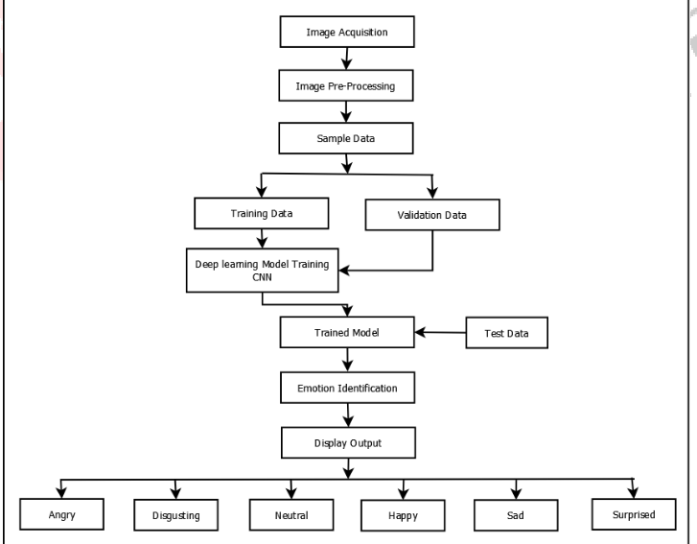
ARCHITECTURE DIAGRAM - DFD
DEPARTMENT OF CSE
DEPARTMENT OF INFOATION TECHNOLOGY

Slide 9

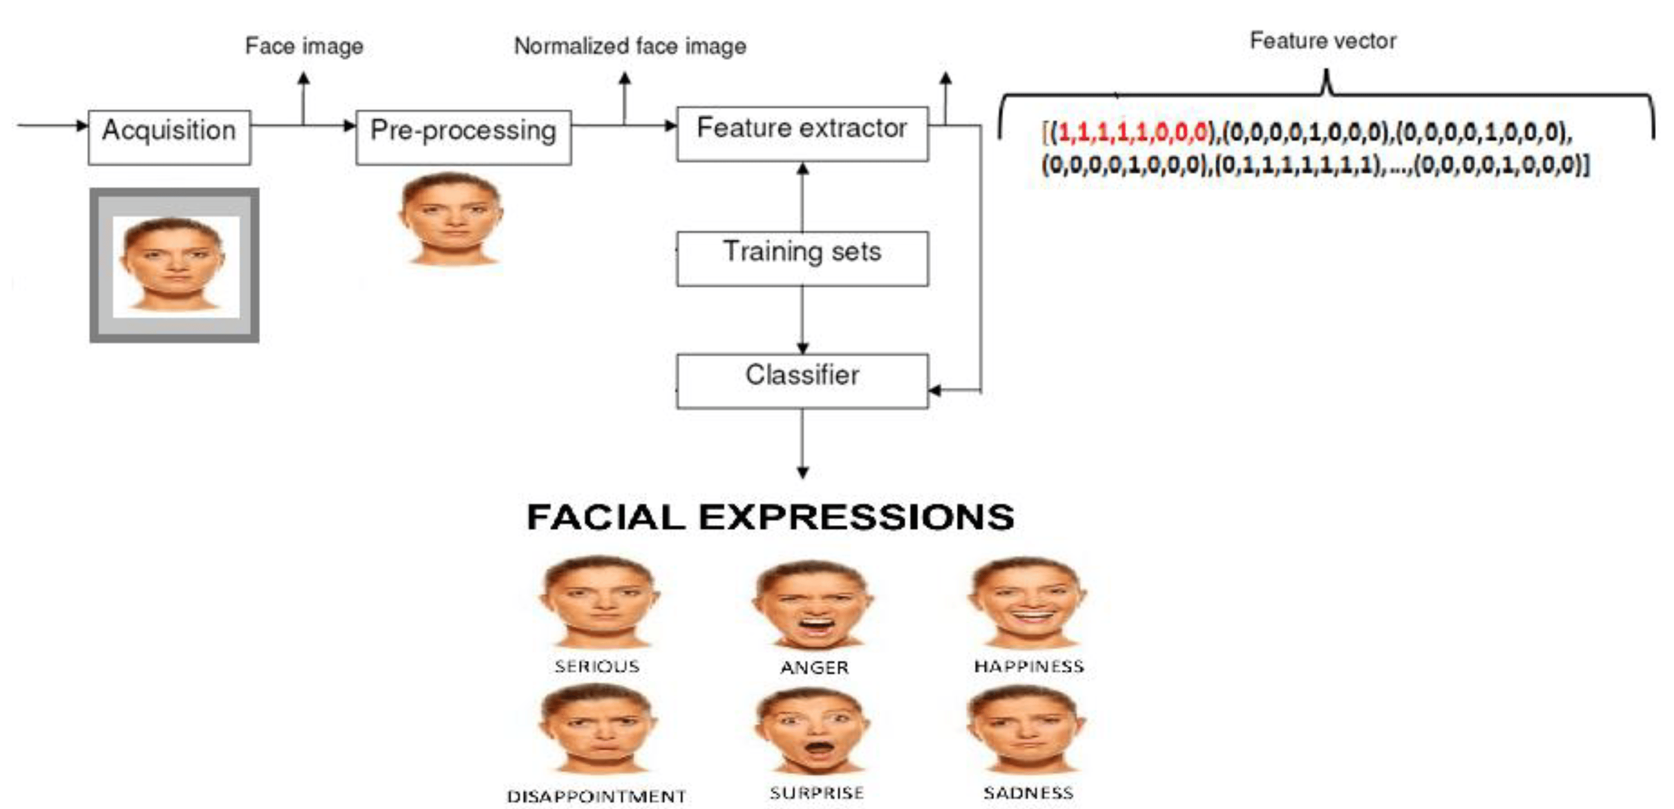
FACIAL EXPRESSION ANALYSIS

Slide 10
ALGORITHM
Input: An image of a customer's face in a restaurant.
Output: A feedback score based on the customer's facial expression.
Step 1: Detect and locate the face from the image using Har-AdaBoost algorithm.
Step 2: Extract and classify the facial features and emotions using a pre-trained CNN model.
Step 3: Assign and aggregate feedback scores based on the detected emotions and their frequencies using a rule-based algorithm.
Step 4: Return the feedback score as the output.
DEPARTMENT OF CSE
DEPARTMENT OF INFORMATION TECHNOLOGY

Slide 11
MODULES (IF APPLICABLE)
Face Detection: Face detection or localization is an important step for image classification since only the principal component of face such as nose, eyes, mouth are needed for classification. Face detection algorithms can be broadly classified into feature, knowledge, template and appearance based methods.
Facial Expression Recognition classification: After learning the deep features, the final step of FER (Facial Expression Recognition) is to classify the given face into one of the basic emotion categories. Unlike the traditional methods, where the feature extraction step and the feature classification step are independent, deep networks can perform FER in an end-to-end way.
Convolutional neural network (CNN):CNN has been extensively used in diverse computer vision applications, including FER. At the beginning of the 21st century, several studies in the FER literature found that the CNN is robust to face location changes and scale variations and behaves better than the multilayer perceptron (MLP) in the case of previously unseen face pose variations, employed the CNN to address the problems of subject independence as well as translation, rotation, and scale invariance in the recognition of facial expressions.
DEPARTMENT OF CSE
DEPARTMENT OF INFORMATION TECHNOLOGY

Slide 12
REFERENCES
1. Darwin C, Prodger P. The expression of the emotions in man and animals. Oxford University Press, USA, 1998.
2. Tian YI, Kanade T, Cohn JF. Recognizing action units for facial expression analysis, IEEE Transactions on pattern analysis and machine intelligence. 2001;23(2):97-115.
3. Ekman P, Friesen WV. Constants across cultures in the face and emotion.” Journal of personality and social psychology. 1971; 17(2):124-129.
4. Ekman P. Strong evidence for universals in facial expressions: a reply to russell’s mistaken critique,
Psychological bulletin. 1994; 115(2)268–287.
DEPARTMENT OF CSE
DEPARTMENT OF INFORMATION TECHNOLOGY

Slide 13
THANK YOU

